Slide 1
LAB LECTURE 4
DISTRIBUTED COMPUTING

Slide 2
DEADLOCK
Deadlocks is a fundamental problem in distributed systems.
A process may request resources in any order, which may not be known a priori and a process can request resource while holding others.
If the sequence of the allocations of resources to the processes is not controlled, deadlocks can occur.
A deadlock is a state where a set of processes request resources that are held by other processes in the set.
Resource->Request->Use->Release

Slide 3
Distributed Systems
A distributed program is composed of a set of n asynchronous processes p1, p2, . . . , pi , . . . , pn that communicates by message passing over the communication network.
Without loss of generality we assume that each process is running on a different processor.
The processors do not share a common global memory and communicate solely by passing messages over the communication network.

Slide 4
Distributed Systems
A process can be in two states: running or blocked.
In the running state (also called active state), a process has all the needed resources and is either executing or is ready for execution.
In the blocked state, a process is waiting to acquire some resource.

Slide 5
WFG
The state of the system can be modeled by directed graph, called a wait for graph (WFG).
In a WFG , nodes are processes and there is a directed edge from node P1 to mode P2 if P1 is blocked and is waiting for P2 to release some resource.
A system is deadlocked if and only if there exists a directed cycle or knot in the WFG.

Slide 6
Edge Chasing Deadlock Detection Algorithm
In edge chasing algorithm, a special message called probe is used in deadlock detection. A probe is a triplet (i, j, k) which denotes that process P_{i} has initiated the deadlock detection and the message is being sent by the home site of process P_{j} to the home site of process P_{k}

Slide 7
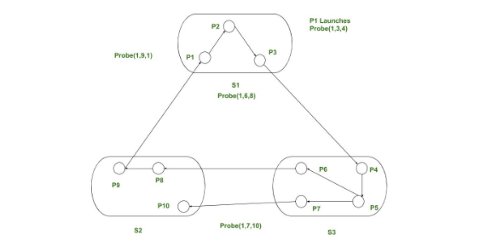
Edge Chasing Deadlock Detection Algorithm

